Slide 1



Relatório sobre diabetes
View in Power BI
Last data refresh:
12/02/2026 16:11:42 UTC
Downloaded at:
13/02/2026 17:16:57 UTC

Slide 2
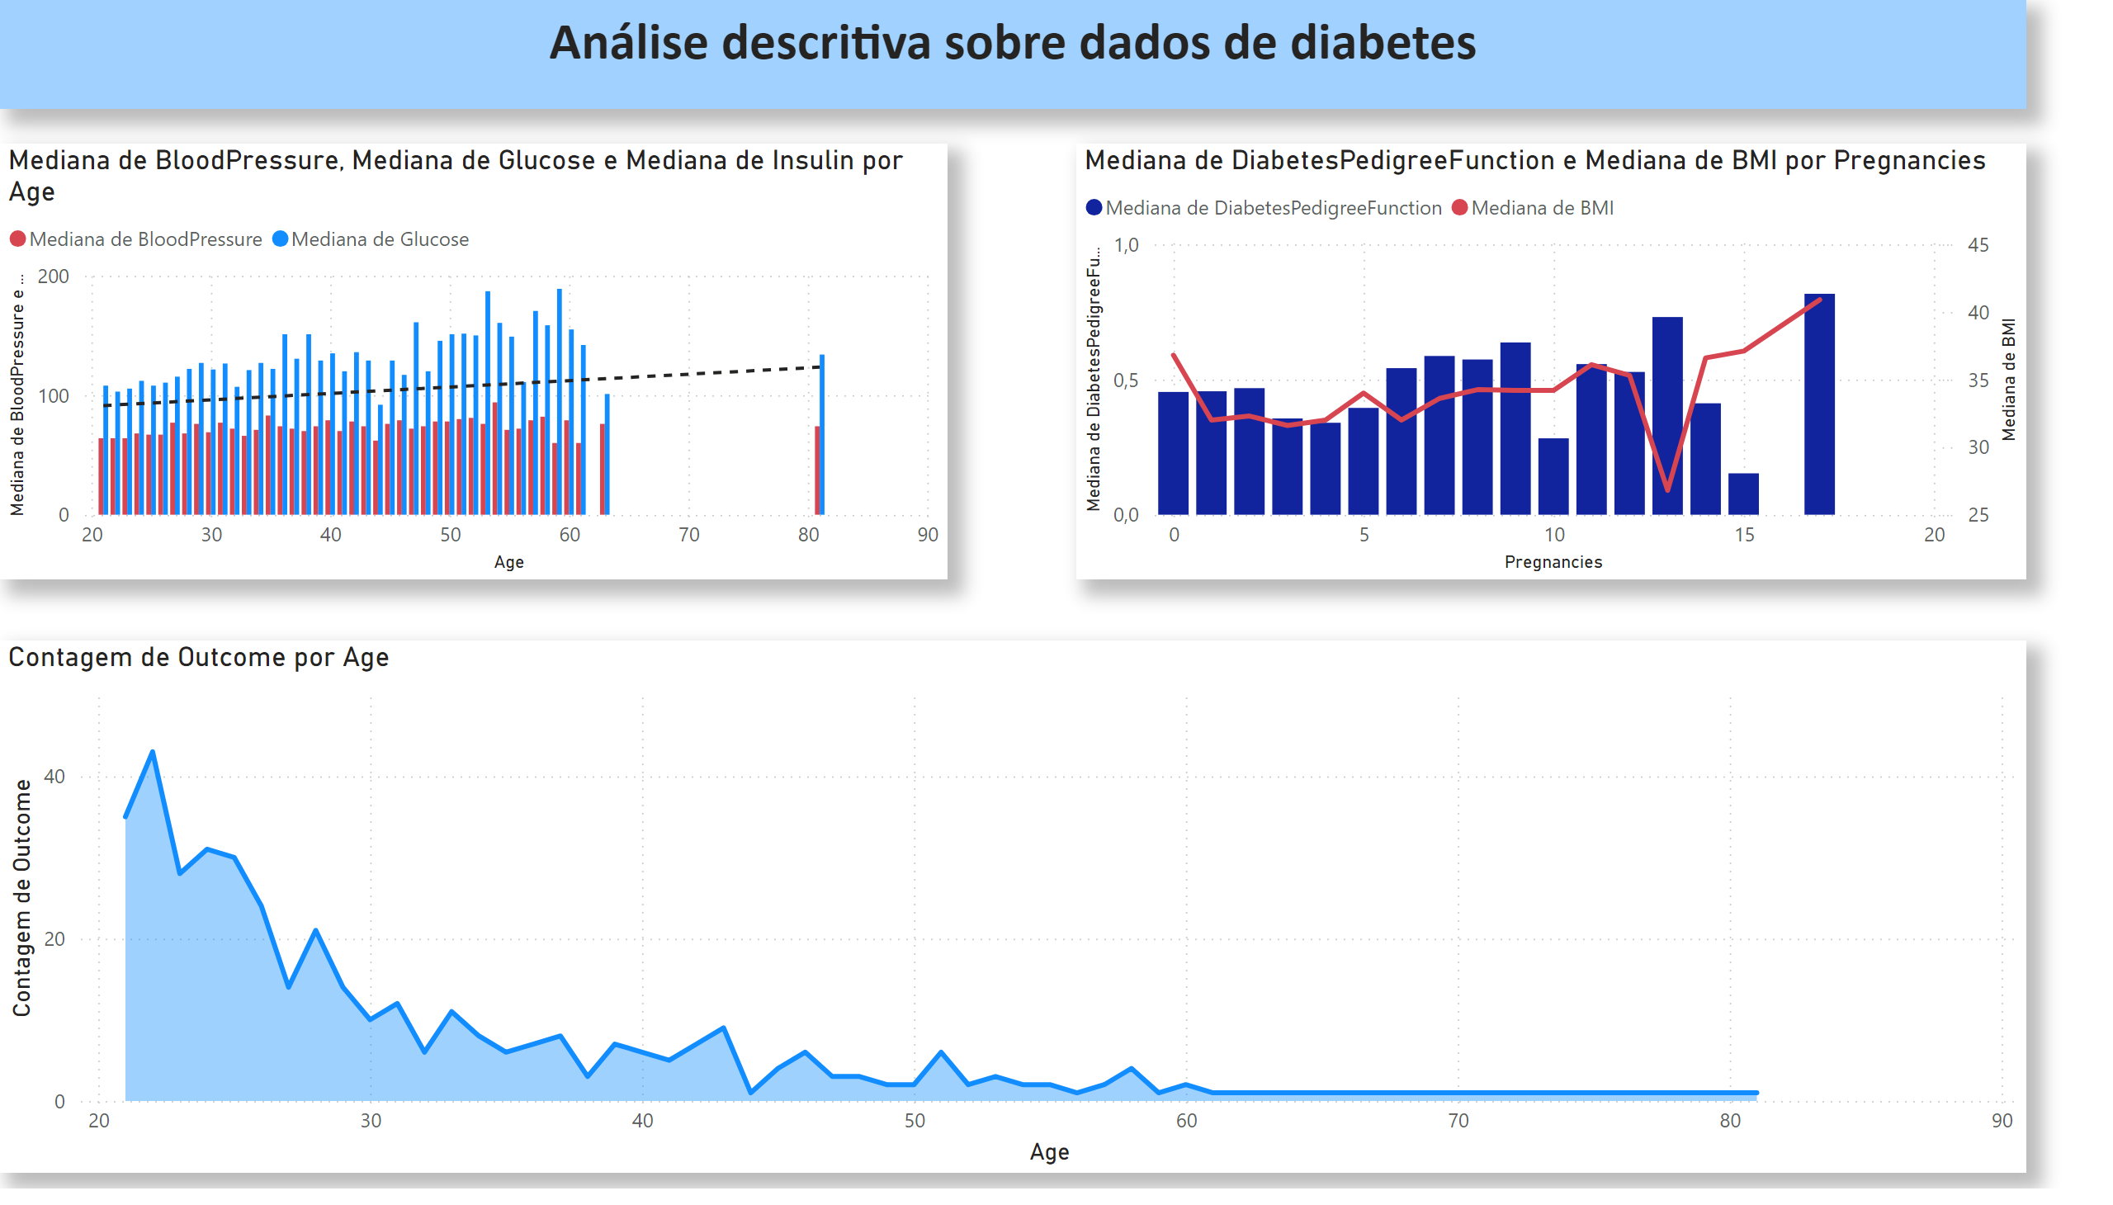
Página 1
Notes:
lineClusteredColumnComboChart
No alt text provided
lineClusteredColumnComboChart
No alt text provided
areaChart
No alt text provided
textbox
No alt text provided

